Slide 1

Module 3
Structural and Fault Based Testing

Slide 2
How good are you as Tester?
For Web page when the login details are given, the next page should load in few ms and if login details are incorrect then show a popup

Slide 3
What comes to your mind?
How much time?
Which page will load next?
What is the popup content?

Slide 4
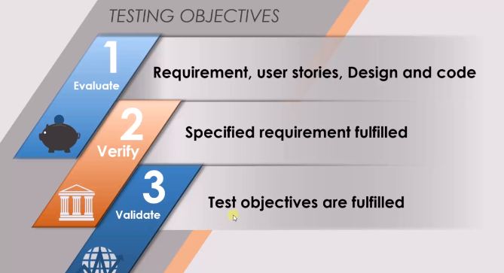

Slide 5
White Box/Structural Testing
How do we test code?
Is testing a code is essential?
Who must do code testing?
What are we supposed to do in code-based testing?
Does it really hold advantages and disadvantages?

Slide 6
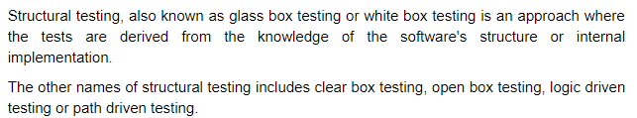
Structural Testing-content from tutorials point

Slide 7
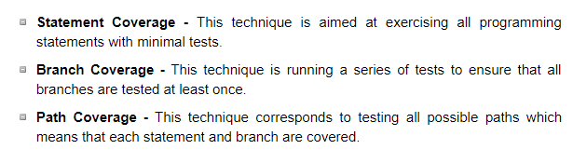
Structural testing techniques

Slide 8
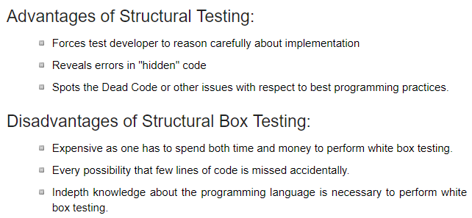

Slide 9
Structural Testing
Code-based testing methods is that, as the name implies, they are all based on the source code of the program tested, and not on the specification.
There are two important code-based testing methods
DD path graph testing
Basis path testing

Slide 10
How do you perform white box testing?
STEP 1) UNDERSTAND THE SOURCE CODE
very knowledgeable in the programming languages
highly aware of secure coding practices
The tester should be able to find security issues and prevent attacks from hackers and naive users who might inject malicious code into the application either knowingly or unknowingly.

Slide 11
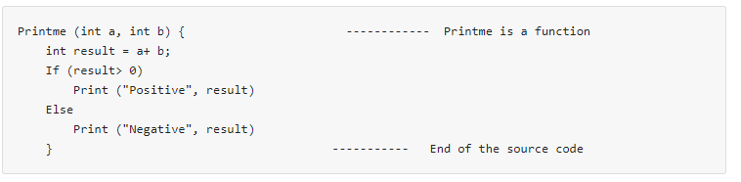
Step 2) CREATE TEST CASES AND EXECUTE
www.guru99.com

Slide 12
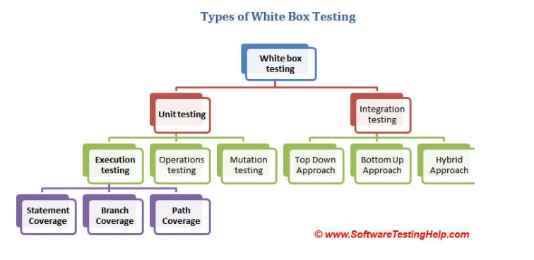

Slide 13
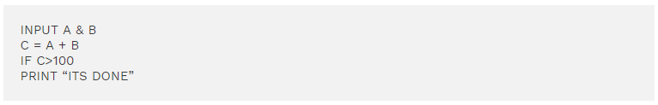
A=40 and B=70 A=33 and B=45
Statement Coverage- need one test case to check all lines of code

Slide 14
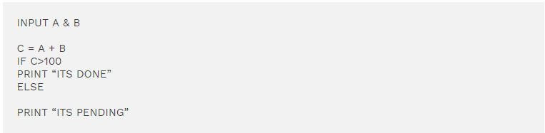
A=33 and B=45 A=25 and B=30
Branch coverage requires two test cases to complete testing

Slide 15
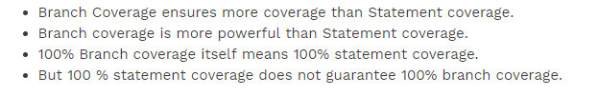
Deductions

Slide 16
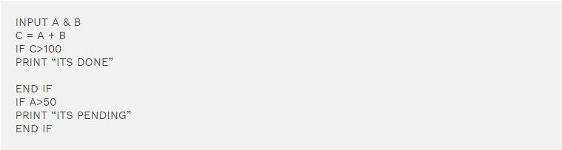
Path Coverage-maximum 4 test cases

Slide 17
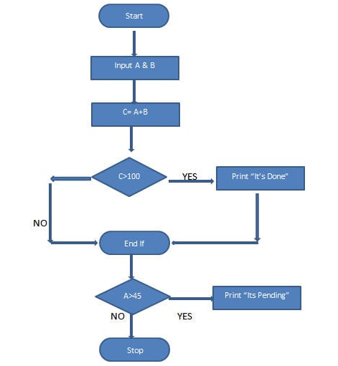
How many test cases to have full coverage?

Slide 18
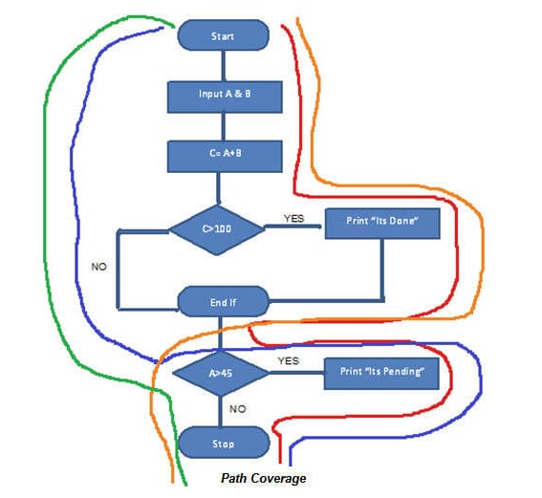
Total
Red Line – TestCase_01 = (A=50, B=60)
Blue Line = TestCase_02 = (A=55, B=40)
Orange Line = TestCase_03 = (A=40, B=65)
Green Line = TestCase_04 = (A=30, B=30)

Slide 19
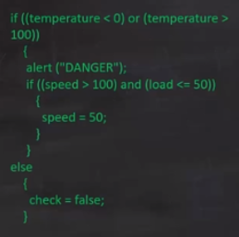
How many test cases are needed to achieve 100% statement coverage?
Options:
A. 1
B.2
C.3
D.4

Slide 20
Which of the following test cases will ensure that statement “06” is executed? A. male rabbits = 1, female rabbits = 1, breed = “yes”. B. male rabbits = 1, female rabbits = 1, breed = “no”. C. male rabbits = 1, female rabbits = 2, breed = “yes”. D. male rabbits = 1, female rabbits = 0, breed = “no”.
01 Input number of male rabbits
02 Input number of female rabbits
03 If male rabbits > 0 and female rabbits > 0 then
04 Input Do you want to breed (Yes / No)
05 If breed = “No”
06 Print “Keep male and female rabbits apart!”
07 End if
08 End If.

Slide 21
Answers A. 1 B. 2 C. 3 D. 4
If the pseudo code below were a programming language ,how many tests are required to achieve 100% statement coverage?
If x=3 then
Display_messageX;
If y=2 then
Display_messageY;
Else
Display_messageZ;
Else
Display_messageZ;

Slide 22
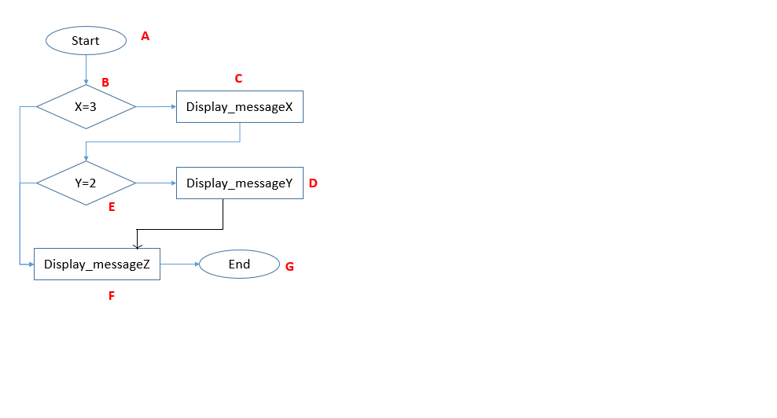
Answer is C = 3 A,B, F,G A,B, C, E, D, F, G A, B,C, E, F, G

Slide 23
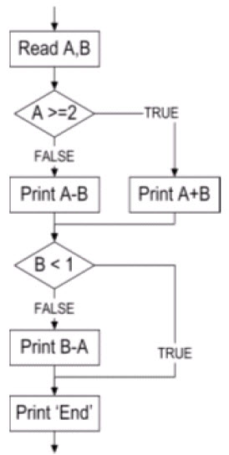
What is the minimum number of test cases required for 100% statement coverage and 100%decision coverage, respectively?
A. Statement Coverage = 1, Decision Coverage = 3.
B. Statement Coverage = 2, Decision Coverage = 3.
C. Statement Coverage = 2, Decision Coverage = 2.
D. Statement Coverage = 3, Decision Coverage = 3

Slide 24
Conversion of program to program graph

Slide 25
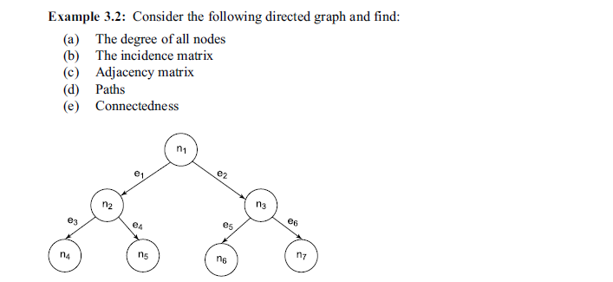

Slide 26
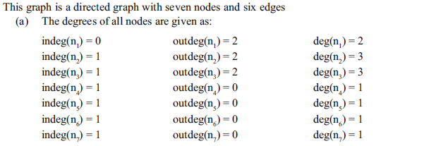

Slide 27
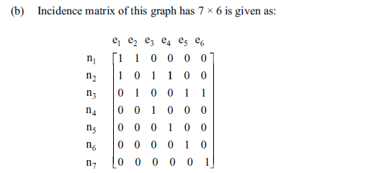

Slide 28
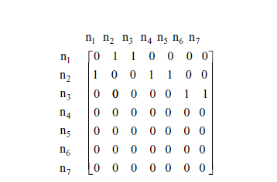

Slide 29
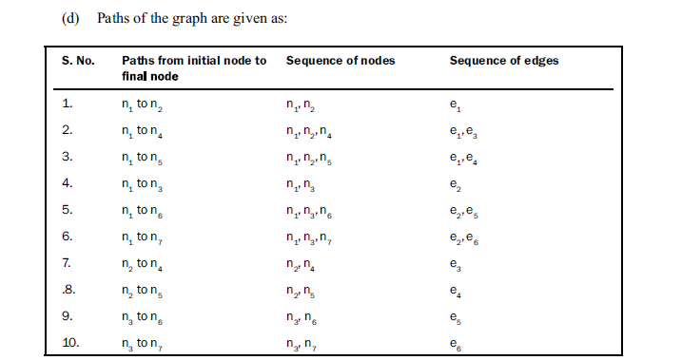

Slide 30
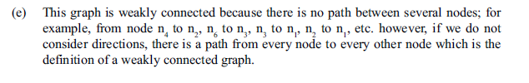

Slide 31
program Graphs
Given a program written in any programming language, its program graph is a directed graph in which nodes are statement fragments, and edges represent flow of control.
If i and j are nodes in the program graph, an edge exists from node i to node j if and only if the statement fragment corresponding to node j can be executed immediately after the statement fragment corresponding to node i.

Slide 32
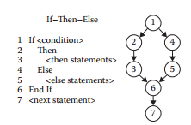
Style Choices for Program Graphs
Deriving a program graph from a given program is an easy process.
program source and sink nodes corresponding to the single entry, single-exit criteria. No loops exist, so this is a directed acyclic graph.

Slide 33
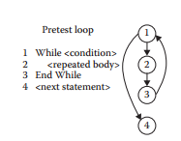
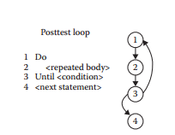
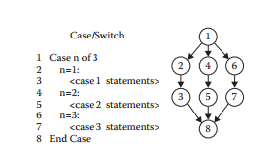

Slide 34
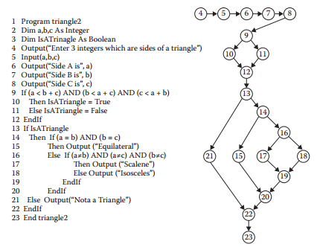
Constructing program graph

Slide 36
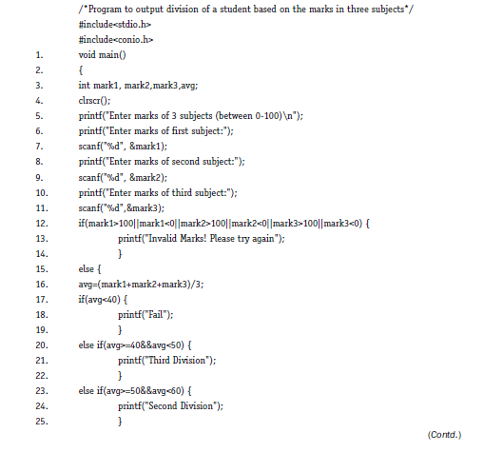

Slide 37
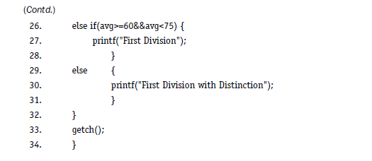

Slide 38
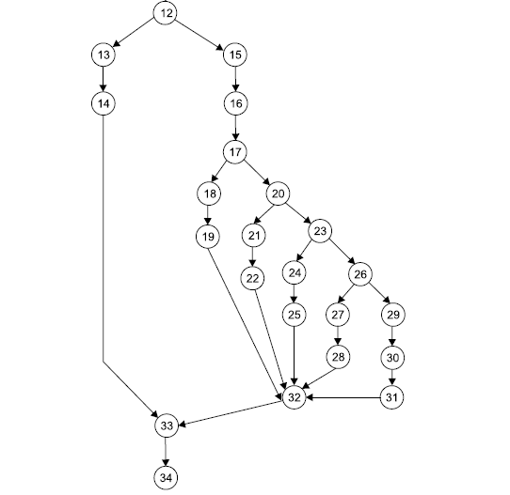

Slide 39
DD-paths
The best-known form of code-based testing is based on a construct known as a decision-to-decision path (DD-path)
We will define DD-paths in terms of paths of nodes in a program graph.
In graph theory, these paths are called chains, where a chain is a path in which the initial and terminal nodes are distinct, and every interior node has indegree = 1 and outdegree = 1.

Slide 40
DD-paths
Definition
A DD-path is a sequence of nodes in a program graph such that
Case 1: It consists of a single node with indeg = 0.
Case 2: It consists of a single node with outdeg = 0.
Case 3: It consists of a single node with indeg ≥ 2 or outdeg ≥ 2.
Case 4: It consists of a single node with indeg = 1 and outdeg = 1.
Case 5: It is a maximal chain of length ≥ 1.

Slide 41
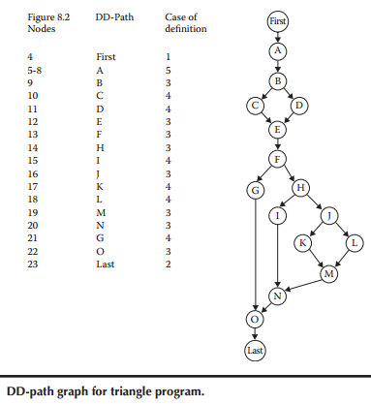

Slide 42
DD path
Node 4 is a case 1 DD-path; call it “first.” Similarly, node 23 is a case 2 DD-path, call it “last.”
Nodes 5 through 8 are case 5 DD-paths.
Nodes 10, 11, 15, 17, 18, and 21 are case 4 DD-paths.
Nodes 9, 12, 13, 14, 16, 19, 20, and 22 are case 3 DD-paths.

Slide 43
DD paths
This process should not be carried by testers—high-quality commercial tools are available, which generate the DD-path graph of a given program.
The vendors make sure that their products work for a wide variety of programming languages.

Slide 44
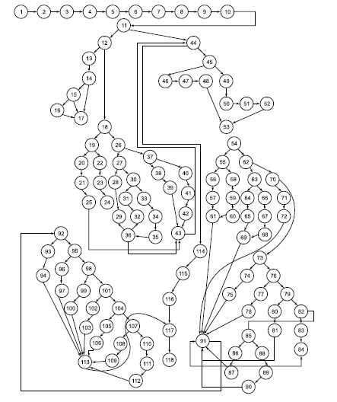
How to identify paths?
If looping occurs, the condition worsens so DD graph
Lets see the DD graph

Slide 45
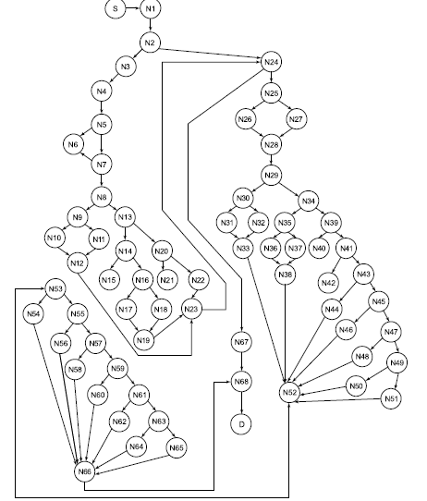
DD-graph
Did it solve our problem?

Slide 46
How to resolve that issue?
Identification of Independent Paths:
What is Independent Path?
At least should contain one new node or one edge which is to be traversed then you call that path as independent path.
We should identify every independent path of a program and pay special attention to these paths during testing.

Slide 47
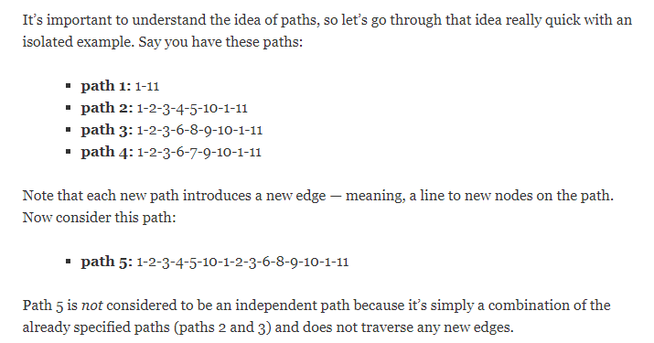

Slide 48
How to identify independent paths?
Few concepts of graph theory are used in testing to identify the independent paths.

Slide 49
Cyclomatic Complexity
Concept involves using cyclomatic number of graph theory which has been redefined as cyclomatic complexity.
This is nothing but the number of independent paths in a program.

Slide 50
McCabe’s Basis Path Method
Maccabe used a directed graph that for determining the Cyclomatic complexity of graph.
Maccabe used the graph with loops for finding Cyclomatic complexity
Cyclomatic complexity=no of linearly independent circuits

Slide 51
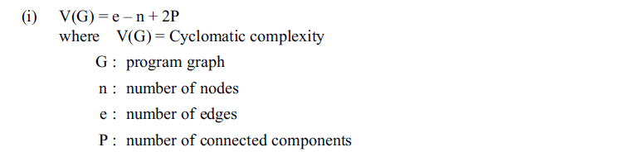
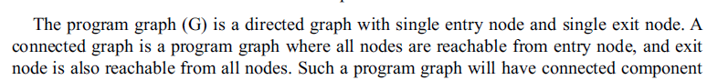
Method -1

Slide 52
Method 2

Slide 53
Method 3
If Predicate node has more than two outgoing edge the structure is required to be changed in order to have only two outgoing edges.

Slide 54
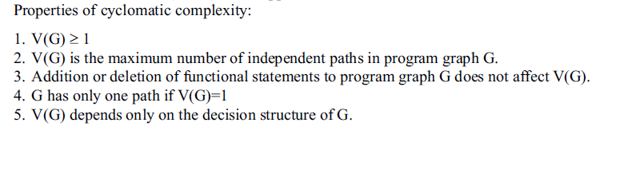

Slide 55
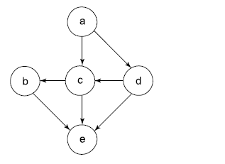
Find the cyclomatic complexity of the given graph

Slide 56
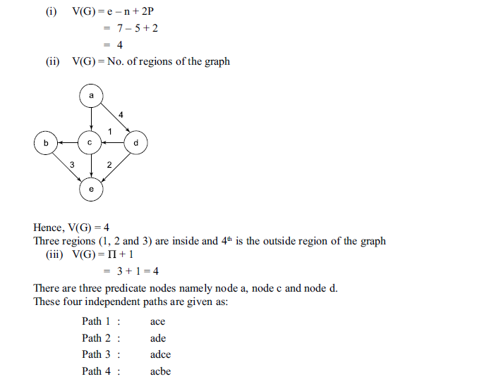

Slide 57
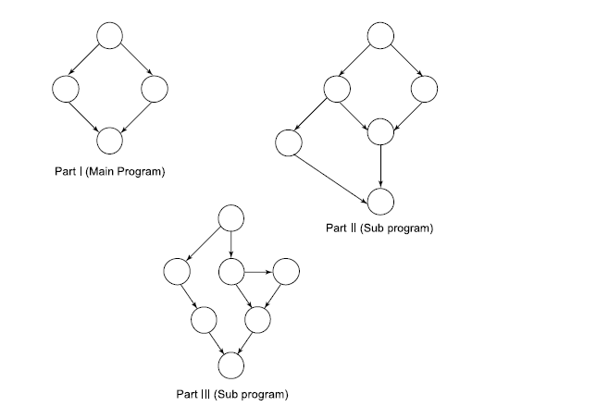

Slide 58
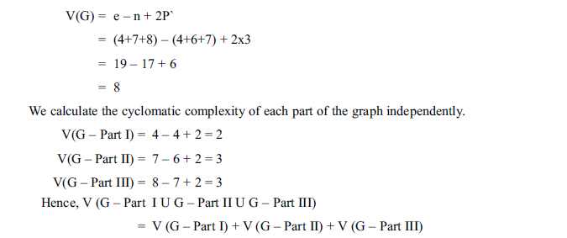

Slide 59
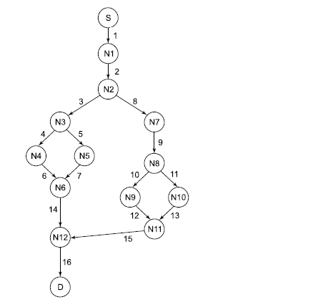
Consider the following DD graph and calculate the cyclomatic complexity.Also find independent paths.

Slide 60
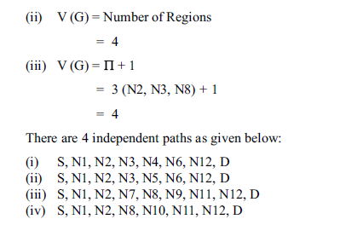
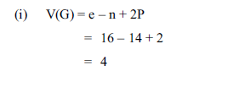
Solution

Slide 61
Topic for Debate Today
Do software testers need technical skills?

Slide 62
Can you list the Test Coverage Metrics in Code Based Testing?

Slide 63
Test Coverage Metrics
Why we need test coverage metric?
Test coverage and code coverage are two of a handful of fundamental metrics used to analyze, track and measure the effectiveness of a project or initiative.
dd path is one of the important test coverage metric.
What is test coverage metric?
It’s a metric which are used to measure the extent to which a set of test cases covers a program.
Amount of testing performed by a set of test cases is called Test Coverage.
Notes:
Test coverage in particular, is a measure of the extent to which the code in question has been tested by a particular test suite.

Slide 64
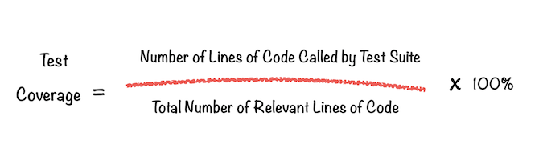

Slide 65
Test Coverage Metrics
Statement Testing / node coverage
Given a set of test cases for a program, they constitute node coverage if, when executed on the pro-gram, every node in the program graph is traversed.
nodes correspond to statement fragments; this guarantees that every statement fragment is executed by some test case.
Also called as c0 coverage.

Slide 66
Test Coverage Metrics
DD-Path Testing
this amounts to traversing every edge in the DD-path graph (or program graph)
For if–then and if–then–else statements, this means that both the true and the false branches are covered (C1p coverage).
Also called as (the C1 metric)

Slide 67
Test Coverage Metrics
Simple Loop Coverage
The C2 metric requires DD-path coverage (the C1
metric) plus loop testing.
The simple view of loop testing is that every loop involves a decision, and we need to test both outcomes of the decision: one is to traverse the loop, and the other is to exit (or not enter) the loop.
C2 = C1coverage + loop coverage

Slide 68
Test Coverage Metrics
Predicate Outcome Testing
testing requires that every outcome of a decision (predicate) must be exercised.
If then and if then else statements are occurring in program then we cover both true and false branches.
Also called as C1p metric

Slide 69
Test Coverage Metrics
Dependent Pairs of DD-Path
Also referred as cd coverage.
Dependencies in dd path is defined by a variable and it is the variable in one DD-path is being referenced in another DD- path.
This dependencies form infeasible paths.
Example of infeasible path
Simple DD path will not find these dependencies so its difficult to find deeper class of faults.

Slide 70
Test Coverage Metrics
Multiple Condition Coverage
CMCC metric addresses the question of testing decisions made by compound conditions.
Covering only true and false conditions of branch might not be enough to uncover all error,
for compound statements we need to form a truth table for each statement in compound conditions and execute all possibilities for statements.

Slide 71
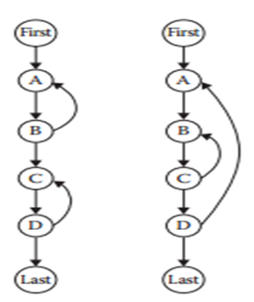
Test Coverage Metrics
Loop Coverage
With help of graph we can study and test loops.
Loops are highly fault prone portion of source code .
Types of loops
Concatenated loops
Nested loops

Slide 72
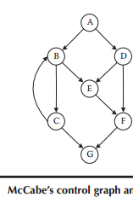
Cyclomatic complexity
V(G) = e– n+ p
VG =e-n+2p
e=10 n=7 p=1
V(g)=5

Slide 73
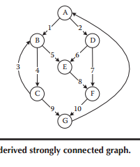
Cyclomatic complexity for strongly connected graph
V(G)=e-n+p
e=11 n=7 p=1
V(G)= 5

Slide 74
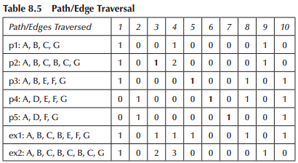
Paths identified are
P1: A B C G
P2: A B C B C G
P3: A B E F G
P4: A D E F G
P5: A D F G

Slide 75
Baseline method
algorithmic procedure (called the baseline method) to determine a set of basis paths.
Step 1:
The method begins with the selection of a baseline path, which should correspond to some “normal case” program execution.
This can be chosen arbitrary; McCabe advises choosing a path with as many decision nodes as possible.

Slide 76
Baseline method
Step 2:
the baseline path is retraced, and in turn each decision is “flipped”;
that is, when a node of out degree ≥ 2 is reached, a different edge must be taken.

Slide 77
Example
Consider mac cabes example and baseline path for graph is A, B, C, B, E, F, G
Path | nodes
Baseline Path | A, B, C, B, E, F, G
decision at node “A” | A ,D, E, F, G
decision at node “D” | A,D,F,G
decision at node “B” | A , B, E, F, G
decision at node “B” | A ,B, C, G

Slide 78
Triangle problem
Path | Nodes | output
Original path: | P1: A-B-C-E-F-H-J-K-M-N-O-last | Scalene
Flip p1 at B | P2: A–B–D–E–F–H–J–K–M–N–O–Last | Infeasible
Flip p1 at F | p3: A–B–C–E–F–G–O–Last | Infeasible
Flip p1 at H | p4: A–B–C–E–F–H–I–N–O–Last | Equilateral
Flip p1 at J | p5: A–B–C–E–F–H–J–L–M–N–O–Last | Isosceles
Flip p1 at B and F | P6: A- B –D –E – F- G – O- Last | Not a triangle

Slide 79
Essential complexity
Essential complexity is a measurement developed by Thomas McCabe to determine how well a program is structured.
McCabe's reduction process is intended to simulate the conceptual replacement of control structures (and actual statements they contain) with subroutine calls, hence the requirement for the control structures to have a single entry and a single exit point.(Nowadays a process like this would fall under the umbrella term of refactoring.)
All structured programs evidently have an essential complexity of 1 as defined by McCabe because they can all be iteratively reduced to a single call to a top-level subroutine
Notes:
Code refactoring is the process of restructuring existing computer code—changing the factoring—without changing its external behavior. Refactoring improves nonfunctionalattributes of the software. Advantages include improved code readability and reduced complexity; these can improve source-code maintainability and create a more expressive internal architecture or object model to improve extensibility

Slide 80
Essential complexity
The bottom line for testers is this: programs with high Cyclomatic complexity require more testing.
What happens if a unit has a higher complexity? Two possibilities: either simplify the unit or plan to do more testing.
If the unit is well structured, its essential complexity is 1; so it can be simplified easily.
If the unit has an essential complexity greater than 1, often the best choice is to eliminate the violations

Slide 81
If a program is well structured it can
always be reduced to a graph
with one path

Slide 82
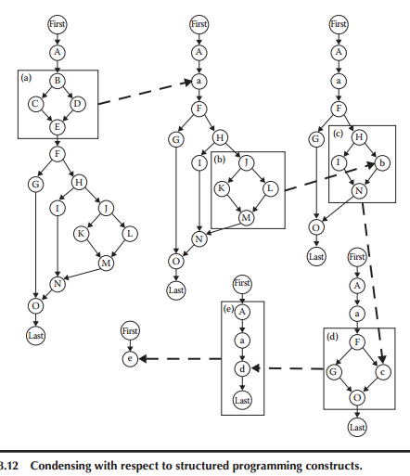

Slide 83
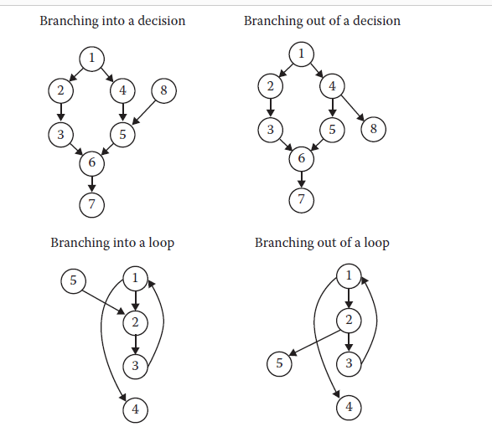
Violations of structured programming

Slide 84
Dataflow Testing

Slide 85
How it differs from path/control flow testing?
In path testing, we identify various paths of a program and design test cases to execute those paths.
We may like to execute every statement of the program atleast once before the completion of testing.
What are we not able to cover in this path testing?

Slide 86
Consider this snippet
1.#include<stdio.h>
2.Void main()
3.{
4.Int a ,b,c;
5.a=b+c;
6.printf(“%d”, a);
7.}
What will be the output?

Slide 87
The output may be
Previous value stored in the memory location assigned to variable ‘a’ or garbage value.
May give unexpected value.
Mistake is in the usage of this variable without first assigning a value into it.
We may assume all variables are automatically assigned to zero initially.
This is purely compiler dependent feature and can’t be generalized.

Slide 88
What is dataflow testing?
Dataflow testing refers to forms of structural testing that focus on the points at which variables receive values and the points at which these values are used.
Two points of concern are:
1. Statements where variables receive values(definition)
2.Statements where these values are used(referenced)

Slide 89
Define/reference Anomalies
variable is defined but never used/referenced.
Variable is used but never defined.
Variable is defined twice before it is used.
Variable is used before even first definition.

Slide 90

Terminologies/definitions in dataflow
Defining Node
Node n ∈ G(P) is a defining node of the variable v ∈ V, written as DEF(v, n), if and only if the value of variable v is defined as the statement fragment corresponding to node n.
Input statements, assignment statements, loop control statements, and procedure calls are all examples of statements that are defining nodes. When the code corresponding to such statements executes, the contents of the memory location(s) associated with the variables are changed.

Slide 91

Usage Node
Node n ∈ G(P) is a usage node of the variable v ∈ V, written as USE(v, n), if and only if the value of the variable v is used as the statement fragment corresponding to node n.
Output statements, assignment statements, conditional statements, loop control statements, and procedure calls are all examples of statements that are usage nodes. When the code corresponding to such statements executes, the contents of the memory location(s) associated with the variables remain unchanged.

Slide 92
Predicate Use
A usage node USE(v, n) is a predicate use (denoted as P-use) if and only if the statement n is a predicate statement; otherwise, USE(v, n) is a computation use (denoted C-use).
The nodes corresponding to predicate uses always have an outdegree ≥ 2, and nodes corresponding to computation uses always have an outdegree ≤ 1.

Slide 93
Definition Use path
A definition/use path with respect to a variable v (denoted du-path) is a path in PATHS(P) such
that, for some v ∈ V, there are define and usage nodes DEF(v, m) and USE(v, n) such that m and
n are the initial and final nodes of the path.

Slide 94
Definition clear path
A definition-clear path with respect to a variable v (denoted dc-path) is a definition/use path in PATHS(P) with initial and final nodes DEF(v, m) and USE(v, n) such that no other node in the path is a defining node of v.

Slide 95

Steps to identify du and dc paths

Slide 96
Testing strategies using du-paths
1. Test all du paths
Strongest dataflow strategy covering all possible du-paths.
All du-paths generated from all variables are tested.
2. Test all uses:
Find atleast one path from every definition of every variable to every use of that variable which can be reached by that definition.
3. Test all definitions:
Find paths from every definition of every variable to atleast one use of that variable.

Slide 97



Slide 98


Slide 99


Slide 100


Slide 101


Slide 102


Slide 103


Slide 104


Slide 105


Slide 106


Slide 107


Slide 108



Slide 109


Slide 110


Slide 111


Slide 112
Consider the Commission problem
Generate program graph
Draw DD-Graph
Perform du-path testing

Slide 113


Slide 114


Slide 115


Slide 116


Slide 117
Slice Based Testing

Slide 118

Understanding Slice
A Slice is a reduced program, that preserves the original program’s behavior for a given set of variables at a chosen point in a program.

Slide 119
Characteristics
Defined for variables and a given point
A slice itself is a program
Ignoring other statements
Focus on relevant parts.
to identify and eliminate unwanted dependencies between variables
to identify problems in mutual exclusive parts of the code by considering set complements or localizing potential problems in segments

Slide 120
Slice based testing
Introduced by Mark Weiser.
Prepares various subsets(called slices) of program with respect to its variables and their selected locations in the program.
Slices are simpler than the original program and simplify the process of testing of the program.

Slide 121
What is Program Slice?
Slice is defined as S(v,n)
Where v- variable
n- Statement number
S(v,n) yields the portions of the program that contributed to the value of v just before statement is executed.

Slide 122
How to perform slicing?
1.“All statements where variables are defined and redefined should be considered”.
5. Int valid=0
15. Valid=1
18. valid=-1
S(valid,5),S(Valid,15),S(Valid,18) are the slices for the variable valid

Slide 123
How to Perform Slicing
2. “All statements where variables are receiving values externally should be considered”.
8. scanf(“%lf,&a);
10.scanf(“%lf”,&b);
12.scanf(“%lf”,&c);
So we create S(a,8) S(b,10) and S(c,12)

Slide 124
How to perform Slicing
3.“ All statements where output of a variable is printed should be considered”.
4. “ All the statements where relevant output is given should be considered”.
26.Printf (“obtuse angled triangle”)
29.printf(“Right Angled triangle”)
32printf(“Acute angled triangle”)
36printf(“Invalid Triangle”)
39printf(“Input values out of range”)
We may create S(a1,26),S(a1,29),S(a1,32),S(valid,36) and S(valid,39)

Slide 125
How to Perform Slicing?
“The statement of all variables may be considered at last statement of a program”
We may create S(a1,42),S(a2,42),S(a3,42),S(valid,42),S(b,42) and S(c,42).

Slide 126
How to obtain Slices
A=3;
B=6;
C=A+B;
S(C,5)
A=3;
B=6;
C=B^{2;}
D=A²+B^{2;}
C=A+B
2. B=6;
3.C=B^{2;}
S(C,3)

Slide 127
Program
Void main()
{
Int a,b,c,d,e;
Printf(“Enter the values of a,b and c”);
Scanf(“%d %d %d”,&a,&b,&c);
d=a+b;
e =b+c;
Printf(“%d”,d);
Printf(“%d”,e);
}

Slide 128
Slices
Slice on criterion S(e,10)=1,2,3,4,5,7,9,10
main()
{
Int a,b,c,d,e;
Prinf(“Enter the values of a,b,c “);
Scanf(“%d%d%d”,&a,&b,&c);
7. e=b+c;
Printf(“%d”,e);
}

Slide 129
Slices
Slice on criterion S(d,10)
main()
{
Int a,b,c,d,e;
Printf(“Enter the values of a,b and c”);
Scanf(“%d%d%d,&a,&b,&c);
d=a+b;
printf(“%d”,d);
10. }

Slide 130
Slices
S(e,7)
S(d,6)
S(a,5)

Slide 131

Slices for greatest of three numbers

Slide 132
Test cases
S:No | Slice | Lines Covered | A | B | C | EO
1 | S(A,6) | 1-6,28 | 9 |  |  | No Output
2 | S(A,13) | 1-14,18,27,28 | 9 | 8 | 7 | 9
3 | S(A,28) | 1-14,18,27,28 | 8 | 8 | 7 | 9
4 | S(B,8) | 1-4,7,8,28 |  | 9 |  | No output
5 | S(B,24) | 1-11,18-20,22-28 | 7 | 9 | 8 | 9
6 | S(C,10) | 1-4,9,10,28 |  |  | 9 | No output
7 | S(C,16) | 1-12,14-18,27,28 | 8 | 7 | 9 | 9
8 | S(C,21) | 1-11,18-22,26-28 | 7 | 8 | 9 | 9
9 | S(C,28) | 1-11,18-22,26-28 | 7 | 8 | 9 | 9

Slide 133
Perform slice-based testing for
Commission Problem

Slide 134


Slide 135


Slide 136


Slide 137


Slide 138


Slide 139



Slide 140


Slide 141


Slide 142
Fault Based Testing

Slide 143
Why Fault Based testing?
Engineers study failures to understand how to prevent similar failures in the future.

Slide 144


Slide 145


Slide 146
Why fault-based testing?
Experience with common software faults sometimes leads to improvements in design methods and programming languages

Slide 147
Examples
Automatic Memory Management in Java
not to spare the programmer the trouble of releasing unused memory, but to prevent the programmer from making the kind of memory management errors (dangling pointers, redundant deallocations, and memory leaks) that frequently occur in C and C++ programs

Slide 148
Exceptions always prevails
Of course, not all programmer errors fall into classes that can be prevented or statically detected using better programming languages. Some faults must be detected through testing, and there too we can use knowledge about common faults to be more effective.

Slide 149
Why fault-based testing needed?
program faults is a valuable source of information for evaluating and designing test suites
Error log of similar kind of applications can be used for developing better test cases.
Fault based models will evaluate and predict how well a test engineer have designed the test cases.

Slide 150
In short
“Fault Based Testing is essential to assess the effectiveness of a test suite”.

Slide 151
Test Suite is not able to make the program fail
1. The test suite is effective but hardly any errors are there in any program. How will a test suite detect errors when they are not there?
2. The test suite is not effective and could not find any errors. Although many errors are there, they could not be selected due to proper selection of test suite. How will errors be detected when the test suite is not effective?

Slide 152
Fault models Used in Language Design
Automated Garbage Collection
Prevents dangling pointers, memory leaks, other memory management faults.
Type Checking
Prevents abnormal and out of range values from being used as input or in computations.

Slide 153
Fault-Based Testing
Model the type of faults we expect to see in a program.
Create alternate versions of the program with those faults.
Design tests that distinguish the real program from the faulty program.
Process of fault seeding - deliberately creating programs with faults to see if our tests can find those intentional faults.
The basic concept of fault-based testing is to select test cases that would distinguish the program under test from alternative programs that contain intentional faults.

Slide 154
Uses of Fault Seeding
Fault seeding can be used to:
To evaluate thoroughness of the test suite and it act as a elements of a test adequacy criterion.
Provides evidence that we have done a good job in testing.
If our tests have not found any new faults, have they found all major issues, or are they bad tests?
Can the existing tests find the seeded faults?

Slide 155
Assumptions in Fault-Based Testing
The effectiveness of fault-based testing depends on:
The quality of the fault model
Assumptions made about the relation of the seeded faults to faults that might actually be present
Seeded are small syntactic changes, like replacing one variable reference by another in an expression or changing a comparison from < to <=.

Slide 156
Assumptions ….
Competent Programmer Hypothesis
A faulty program differs from a correct program only by a small textual change.
If so, we only must distinguish the program from all such small variants(Alternate program) by executing test cases and test cases fails on anyone by detecting faults.
It is an assumption that SUT (source under test ) is “close to” correct program.

Slide 157
Assumptions….
Many faults are small syntactical errors.
Conceptual faults often manifest as syntactical errors.
Complex faults may result in larger textual differences.
However, mutation testing is still valid if test cases for simple issues can detect complex issues.
Coupling Effect Hypothesis - complex faults can be modeled as a set of small faults.

Slide 158
Assumptions….
A complex change to a program is a series of small changes.
If one of these small changes is not masked by the effects of other changes, then a test case that can notice that change may also detect a more complex change.
Test cases enough for detecting the simpler faults are enough also for ∆ coupling effect hypothesis
detecting the more complex fault. This is known as the coupling effect.
Mutation testing is effective if both the competent programmer hypothesis and coupling effect hypothesis hold.

Slide 159
MUTATION BASED TESTING

Slide 160
Why Mutation Testing?
All test cases are executed
Effective coding
Bug Free
Select few test cases and make a test suite
Using the suite we try to fail the program
If it don’t fail
1. Program is Effective and also the test suite.
2. Test Suite is not Effective

Slide 161
Mutation analysis
Mutation analysis is the most common form of software fault-based testing.
A fault model is used to produce hypothetical faulty programs by creating variants of the program under test.
Variants are created by “seeding” faults, that is, by making a small change to the program under test following a pattern in the fault model.
The patterns for changing program text are called mutation operators, and each variant program is called a mutant.

Slide 162

What is mutation?
Common understandability is something not “usual”. Due to some conditions normal becomes abnormal.

Slide 163

What is Mutation Testing?
“Process of changing the program”.

Slide 164
Mutation Testing
Encode common syntactic faults as mutation operators.
SUT
if((a == 1) && !b){ ...
Functions that take in candidate program statements and insert the modeled fault.
Mutation Operator
Produces a mutant.
A clone of the program with 1+ seeded faults.
if((a == 1) || !b){ ...
Mutant

Slide 165
Objective of Mutation Testing
“The goal of Mutation Testing is to assess the quality of the test cases which should be robust enough to fail mutant code. This method is also called as Fault based testing strategy as it involves creating fault in the program”.

Slide 166

Mutation Testing (Terminologies)

Slide 167

Mutation analysis (Terminologies)

Slide 168
Steps to execute Mutation Testing
Step 1: Faults are introduced into the source code of the program by creating many versions called mutants. Each mutant should contain a single fault, and the goal is to cause the mutant version to fail which demonstrates the effectiveness of the test cases.
Step 2: Test cases are applied to the original program and also to the mutant program. A test case should be adequate, and it is tweaked to detect faults in a program.

Slide 169
Steps to execute Mutation testing
Step 3: Compare the results of original and mutant program.
Step 4: If the original program and mutant programs generate the same output, then that the mutant is killed by the test case. Hence the test case is good enough to detect the change between the original and the mutant program.
Step 5: If the original program and mutant program generate different output, Mutant is kept alive. In such cases , more effective test cases need to be created that kill all mutants.

Slide 170
Mutation Testing
Select mutation operators - code transformations that represent classes of faults that we are interested in.
Generate mutants by applying mutation operators to the program.
Execute the same tests against the program and mutants to kill mutants.
A mutant is killed if the test passes on the original program and fails on the mutant.
A mutant not killed is considered live.

Slide 171
Mutation Testing
Most mutation operators reflect small syntactic mistakes.
Programmers do make such mistakes. However, many faults are actually conceptual mistakes.
Mistaken assumptions about requirements.
Forgotten requirements.
Is mutation testing a viable technique?

Slide 172
Viability of Mutation Testing
Mutation testing is valid if seeded faults are
representative of real faults.
Competent Programmer Hypothesis
Coupling effect

Slide 173
Mutant Quality
To be used in testing, mutants must be:
Syntactically correct (valid)
Mutants must compile and execute.
Plausible (useful)
Must provide information on how the system works.

Slide 174
Mutant Quality
Mutants might remain live if:
They are equivalent to the original program.
for(i=0; i < 10; i++)
for(i=0; i != 10; i++)
Identifying equivalency is NP-hard.
Test suite is inadequate for that mutation.
(a <= b) and (a >= b) cannot be differentiated if a==b in the test case.

Slide 175
Mutation Coverage
Adequacy of the suite can be measured as:
(# mutants killed) (total mutants)
Mutants can be equivalent when both the original and the mutant are wrong.
Helps ensure that the test suite is robust
against the modeled mutation types.

Slide 176

How to create mutant programs?
A mutation is nothing but a single syntactic change that is made to the program statement. Each mutant program should differ from the original program by one mutation.

Slide 177
Mutation Operators
Intended to model common types of faults.
Using mutation operator we can generate mutants without human intervention using some tools.
Tend to be simple syntactic faults.
Replacing one variable reference with another.
Changing a comparison from < to <=.
Referencing a parent class instead of a child.
Mutation operators are syntactic patterns defined relative to particular programming languages.

Slide 178
What to change in a mutant program?
Operand replacement operators | Expression Modification Operators | Statement modification Operators
Replace the operand with another operand(x with y or y with x) or with the constant value. | Replace an operator or insertion of new operators in a program statement. | Programmatic statements are modified to create mutant programs.
Example- If(x>y) replace x and y values If(5>y) replace x by constant 5 | Example- If(x==y) We can replace == into >= and have mutant program as If(x>=y) and inserting ++ in the statement If(x==++y) | Example- Delete the else part in an if-else statement Delete the entire if-else statement to check how program behaves Some of sample mutation operators: GOTO label replacement Return statement replacement Statement deletion Unary operator insertion(Like - and ++) Logical connector replacement Comparable array name replacement Removing of else part in the if-else statement Adding or replacement of operators Statement replacement by changing the data Data Modification for the variables Modification of data types in the program

Slide 179
Mutation Score
Mutation Score=Number of mutants killed
Total Number of Mutants

Slide 180
Automation of Mutation Testing
Mutation testing is extremely time consuming and complicated to execute manually. To speed up the process, it is advisable to go for automation tools. Automation tools reduce cost of testing as well.
List of tools available
Ninja Turtles- .net mutation testing tool
Mutagenesis- PHP mutation testing framework
Jester- Mutation Testing Tool for Java

Slide 181
Actual Test suite for 3 numbers
S:No | A | B | C | Expected Output
1 | 6 | 10 | 2 | 10
2 | 10 | 6 | 2 | 10
3 | 6 | 2 | 10 | 10
4 | 6 | 10 | 20 | 20

Slide 182
Mutated Statements
Mutant No | Line No | Original Line | Modified Line
M1 | 11 | If(A>B) | If(A<B)
M2 | 11 | If(A>B) | If(A>(B+C))
M3 | 12 | If(A>C) | If(A<C)
M4 | 20 | If(C>B) | If(C=B)
M5 | 16 | Printf(“ the largest number is:%f\n”,C); | Printf(“ the largest number is:%f\n”,B);

Slide 183
Actual output of Mutant 1
Test case | A | B | C | EO | AO
1 | 6 | 10 | 2 | 10 | 6
2 | 10 | 6 | 2 | 10 | 6
3 | 6 | 2 | 10 | 10 | 10
4 | 6 | 10 | 20 | 20 | 20

Slide 184
Actual output of Mutant 2
TEST CASE | A | B | C | EO | AO
1 | 6 | 10 | 2 | 10 | 10
2 | 10 | 6 | 2 | 10 | 10
3 | 6 | 2 | 10 | 10 | 10
4 | 6 | 10 | 20 | 20 | 20

Slide 185
Actual Output of Mutant 3
Test case | A | B | C | EO | AO
1 | 6 | 10 | 2 | 10 | 10
2 | 10 | 6 | 2 | 10 | 2
3 | 6 | 2 | 10 | 10 | 6
4 | 6 | 10 | 20 | 20 | 20

Slide 186
Actual Output of M4
Test case | A | B | C | EO | AO
1 | 6 | 10 | 2 | 10 | 10
2 | 10 | 6 | 2 | 10 | 10
3 | 6 | 2 | 10 | 10 | 10
4 | 6 | 10 | 20 | 20 | 10

Slide 187
ACTUAL OUTPUT OF M5
TEST CASE | A | B | C | EO | AO
1 | 6 | 10 | 2 | 10 | 10
2 | 10 | 6 | 2 | 10 | 10
3 | 6 | 2 | 10 | 10 | 2
4 | 6 | 10 | 20 | 20 | 20

Slide 188

MUTATION SCORE
MUTATION SCORE=4/5=0.8

Slide 189
ADDITIONAL TEST CASE
TEST CASE | A | B | C | EO
1 | 6 | 10 | 2 | 10
2 | 10 | 6 | 2 | 10
3 | 6 | 2 | 10 | 10
4 | 6 | 10 | 20 | 20
5 | 10 | 5 | 6 | 10

Slide 190
Mutation Operators

Slide 191


Slide 192


Slide 193
Operand Modifications
X for Y replacement
Replace constant C1 with constant C2.
Replace constant C with scalar variable S.
Replace scalar S for constant C.
Replace scalar S1 with scalar S2.
Replace scalar/constant with array reference A[I].
Replace array reference A[I] with scalar/constant.
Replace array reference with another array reference.
Either another array or another index in the same array.

Slide 194
Expression Modifications
Arithmetic Operators
Binary operators: x (+, -, *, /, %) y
Unary operators: +x, -x
Shortcut operators: x++, ++x, x--, --x
Arithmetic Operator Replacement
Replace binary/unary/shortcut operator with another.
Replace shortcut operator with a unary operator.
Arithmetic Operator Insertion
Insert an additional operator into an expression.
Arithmetic Operator Deletion
Remove an operator from an expression.

Slide 195
Expression Modifications
Conditional Operators
Binary: x (&&, ||, &, |, ^) y
Unary: (~, !)x
Relational Operators
x (>, >=, <, <=, ==, !=) y
Shift Operators
x (>>, <<, >>>>) y
(Conditional/Relational/Shift) Operator Replacement, Insertion Deletion

Slide 196
Expression Modifications
Shortcut Operators
x (+=, -=, *=, /=, %=, &=, |=, ^=, <<=, >>=) y
Shortcut Operator Replacement
Absolute Value Insertion
Replace a subexpression with abs(e).
Constant for Predicate Replacement
Replace a predicate (a || b) with a constant truth value (true/false).

Slide 197
Statement Modifications
Statement Deletion
Remove a random statement from the program.
Switch Case Replacement
Replace the label of one case with another.
End Block Shift
Move closing brackets to an earlier or later location.

Slide 198
Language-Specific Modifications
Mutation operators can be written for a particular language.
Java:
this insertion/deletion
Static modifier insertion/deletion
Member variable initialization deletion
Default constructor deletion
Getter/Setter method replacement

Slide 199
Mutation Testing/ Fault based adequacy criteria

Slide 200

Example: Transduce

Slide 201
Weak Mutation Testing
Mutation testing is expensive.
Must run all tests against all mutants.
Many mutants typically generated.
One mutation operator applied per mutant.
If cost is an issue:
“weak” mutation testing - seed multiple faults per mutants.

Slide 202
Weak Mutation Testing
Seed multiple faults into a single mutant.
Called a “meta-mutant”
Divide the program into segments and track internal state of both original and all mutants when executing a segment.
Kill all detected mutants when intermediate state differs instead of waiting for output.
Decreases the number of test executions.

Slide 203
Statistical Mutation Testing
A test suite that kills some mutants may be as effective at finding real faults as one that kills all mutants.
Mutation testing can be used to obtain a statistical estimate of the ability of the suite to detect mutations.
Randomly generate N mutants.
Samples are considered as valid in statistical model if samples represent real faults.
Target 100% coverage over the sample.

Slide 204
Estimating Number of Real Faults
Mutants can be used to estimate the number of remaining faults in a program.
Number of Seeded Faults Seeded Faults Detected
=
Number of Real Faults Real Faults Detected

Slide 205
Activity
How many mutations are possible for Relational Operator Replacement, Arithmetic Operator Replacement
Apply relational operator replacement operation to statement 4, design a test that would kill that mutant.
Design an equivalent mutant.
Design a valid, but useless mutant.
public int[] makePositive(int[] a){ int threshold = 0;
for(int i=0; i < a.length; i++){ if(a[i] < threshold){
a[i]= -a[i];
}
}
return a;
}

Slide 206
Activity - Solution
How many mutations are possible:
Relational Operator Replacement:
for(int i=0; i < a.length; i++){
(>=, <, <=, ==, !=), 5 mutations
if(a[i] < threshold){
(>, >=, <=, ==, !=), 5 mutations
Arithmetic Operator Replacement
for(int i=0; i < a.length; i++){
Shortcut replacement, (++i, i--, --i), 3 mutations
a[i]= -a[i];
Unary replacement, (+a[i]), 1 mutation
Unary to shortcut replacement, (a[i]++, ++a[i], a[i]--, --a [i]), 4 mutations

Slide 207
Activity - Solution
Apply the relational operator replacement operation to statement 4:
if(a[i] < threshold){ becomes:
if(a[i] == threshold){
Design a test case that would kill that mutant.
a[-1,0,1]
-1 would not become positive.

Slide 208
Activity - Solution
Design an equivalent mutant.
Can do so by applying the relational operator replacement operation to statement 4:
if(a[i] < threshold){ becomes:
if(a[i] <= threshold){
Since threshold=0, and -0 = 0, no test would detect this fault.
Does not help us test, as the fault cannot cause a failure.

Slide 209
Activity - Solution
Design a valid, but useless mutant.
For example: mutant that compiles, but trivially fails.
Apply the relational operator replacement operation to statement 4:
if(a[i] < threshold){ becomes:
if(a[i] > threshold){
Any positive numbers are made negative, all negative remain negative. Almost any test would detect this.
Many mutants are useless for detecting real faults.

Slide 210
We Have Learned
Mutation testing is the process of inserting faults to help develop a test suite that can detect unknown real faults.
Mutation operators automatically create faulty versions of a program.
Operators model expected fault types.
Tests are judged according to their ability to detect faults.

